Slide 1
2024 OSHA and HIPAA In-service
(self-taught)
After printing “PRCE OSHA test and sign offs”, click through this OSHA /HIPAA presentation, then return the paper works to Annis Felicien, MSN, RN.
(If you want the Hep. B series, say so in writing to her)

Slide 2
OSHA

Slide 3
OSHA Background
OSHA = Occupational Safety and Health Administration
Purpose = to provide every employee with a safe and healthy workplace. (“employee” is equal to “volunteers” throughout this Power Point)

Slide 4
Employers Rights
Employers are required to comply
Can not restrict inspection
Employers are always held accountable for hazards in the workplace

Slide 5
Employee rights
Safe and healthy workplace
Controls for hazards should be in place
May request an inspection
Won’t be discharged or discriminated against due to reporting an illness or injury

Slide 6
Employee and volunteer Responsibilities
Comply with OSHA rules and regulations
Participate in the safety program
Report any occupational illnesses or injuries to the Safety Coordinator (Nurse Manager)

Slide 7
Safety contacts
The Safety Directors are:
  Gail Duhon, Executive Director
  Maegan Ramirez, Center Director
The Safety Coordinator is:
  Annis Felicien, MSN, RN, Nurse Manager

Slide 8
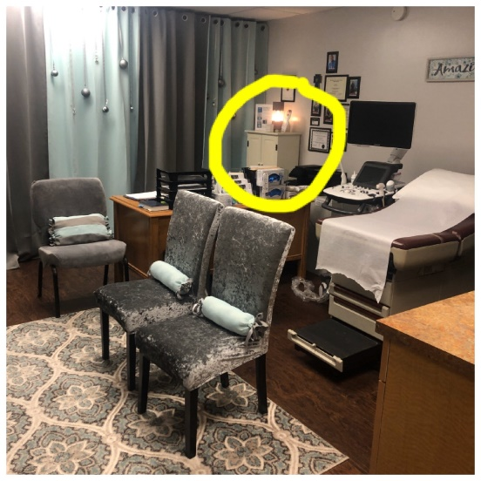
OSHA manual
The manual contains the following policies:
  Bloodborne Pathogens
  Hazard Communication Standard
  Infection Control Plan
  Hazard Communication Plan
  Labeling/MSDS sheets
  General Safety/Emergency Action Plan
  Workplace Violence/Boundaries with Clients/Potential Terrorism
  Ergonomics
  Tuberculosis
  Training
  Record Keeping
  LOCATED IN WHITE CABINET NEXT TO ULTRASOUND ROOM DESK

Slide 9
Bloodborne pathogen plan
The purpose is to keep from being injured by bloodborne disease (diseases spread by blood).
  Located in the OSHA manual, in the Ultrasound Room

Slide 10

BloodBorne Pathogen Plan
Utilize universal precautions:
  Universal Precautions is treating blood and other potentially infectious materials (such as urine) as if known to be infectious.
Engineering controls:
  Never reach into bags, dump them out to sort
  Have clients handle urine for pregnancy tests, not you

Slide 11
Bloodborne Pathogen Plan
Personal Protective Equipment
  Use gloves when sorting clothes in case they are contaminated or there is something sharp in there
  Use gloves when cleaning after a pregnancy test
  Use gloves when handling dirty diapers or helping a child with sinus drainage
  Use gloves when cleaning after vomit
  Use gloves when cleaning toys
  Use eye goggles and gloves when changing out disinfectant solution or the rinse tube when using GUS system
  Use exam gloves when performing abdominal and vaginal ultrasounds
  Wash hands and use hand sanitizer often
  When in doubt, use gloves
Covid-19 Personal Protective Equipment
  Gloves
  Eye protection, e.g.: goggles, safety glasses
  Facemask
  Face shield

Slide 12
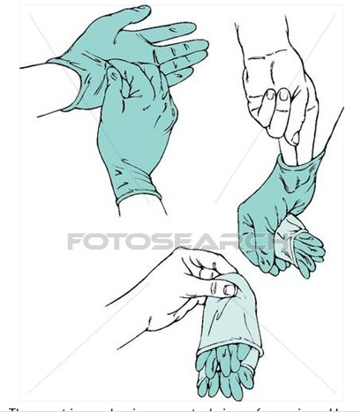
“prce Proper Glove Removal” Technique
Pinch the first glove at the wrist and pull down touching only the outside of the glove.
Ball up the removed glove in the palm of your gloved hand.
Slide an ungloved finger inside the other glove touching only the inside with your ungloved finger.
Peel the second glove off inside out, trapping it in your palm.
Discard the balled up gloves in the proper receptacle.
Gloves with any visible blood, urine, vaginal secretions, or OPIM are to be disposed in the “Biohazard” garbage bin and all other gloves may be discarded in the closest regular garbage bin.
Wash hands
Notes:
Helps to prevent the spread of pathogens….do demonstration
Added the picture!

Slide 13
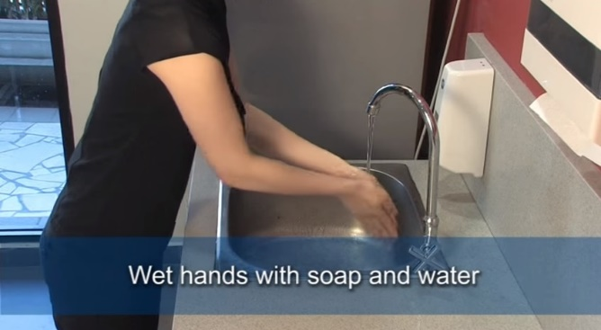
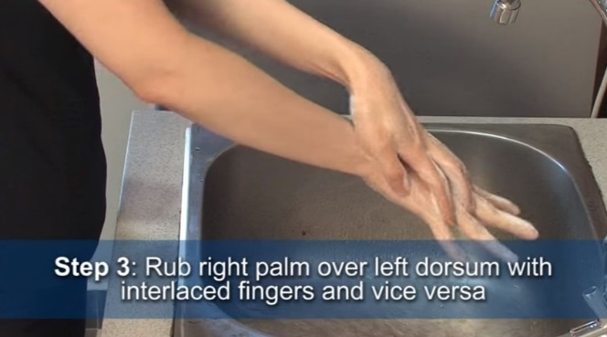
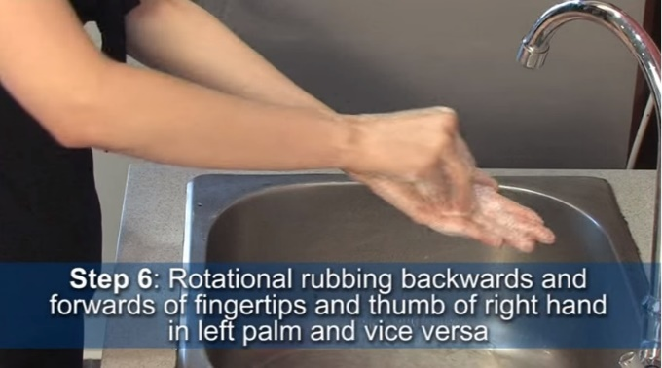
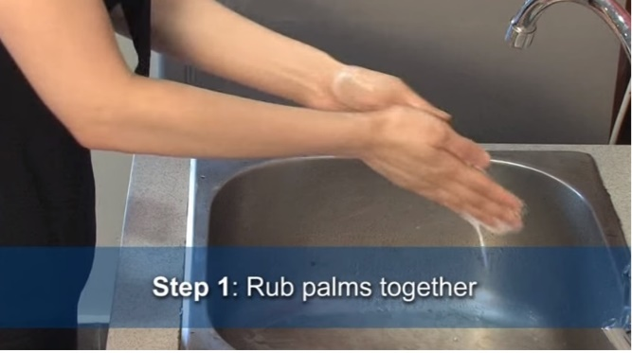
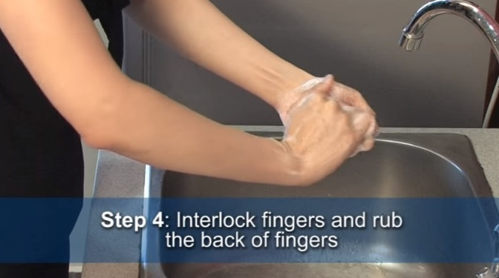
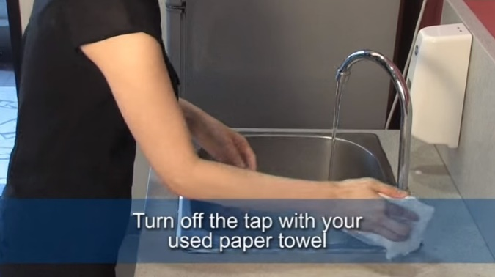
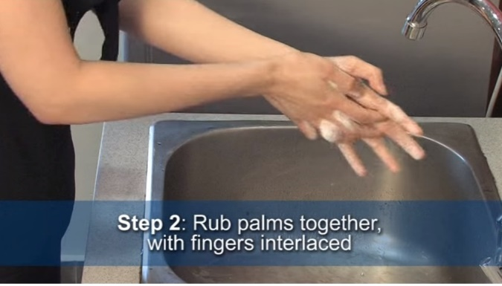
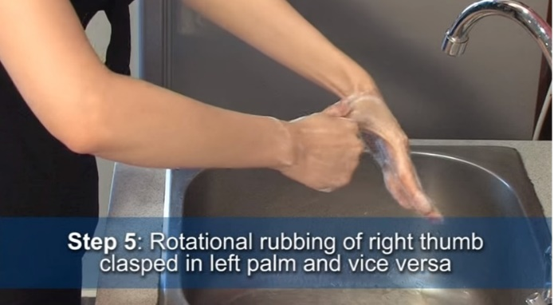
Prce hand wash technique
Pinch under each fingernail next
Lastly, open the door with your used paper towel!

Slide 14
Bloodborne pathogen exposure
If you are exposed to blood or any bodily fluid that might contain blood while here at PRCE:
  Wash the area thoroughly with soap and water
  Contact Gail Duhon, Maegan Ramirez, or Annis Felicien, MSN, RN, Nurse Manager for further assistance

Slide 15
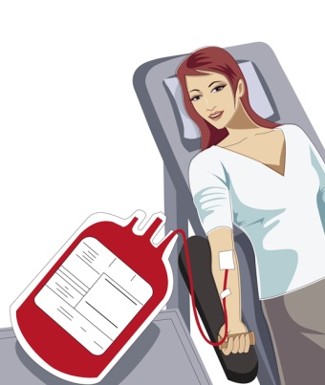
Hepatitis B and C
Hepatitis B Hepatitis C
Bloodborne Usually via needles
Jaundice Extreme fatigue
*Research of risks and benefits to the Hep. B vaccine is recommended.

Slide 16

HIV
Contracted through intimate contact, blood, and needles
Symptoms are swollen lymph nodes and unusual infections

Slide 17
tuberculosis
Airborne (usually from a cough)
It is curable
A TB screening form needs to be complete for all volunteers and staff when they first come to PRCE. The TB screening consists of four questions and is completed by completion of training, prior to hire date, or within one week of getting notice of this policy.

Slide 18
General Safety Basics
When in doubt, glove up
Always use the right tool for the right job (such as ladders, step stools, etc)
Keep hallways and floors clean
No carpeting over extension cords
Only one file cabinet drawer open at a time
Paper cutter blades should be down when not in use.
Always report safety issues to the Safety Directors or Coordinator

Slide 19

Latex Allergy
There are numerous items containing latex including, but not limited to:
  Band-Aids
  Diaphragms
  Condoms
  Elastic
Signs or symptoms include: itching, irritation, asthma, and anaphylaxis

Slide 20
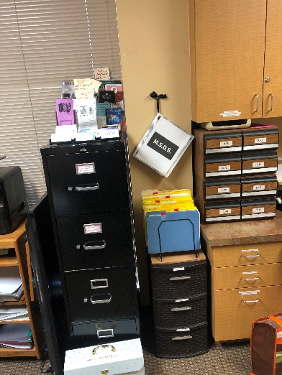
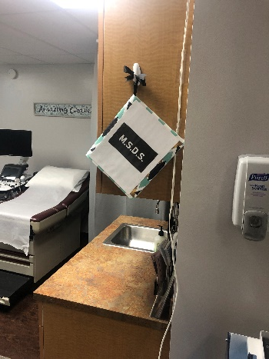
Hazardous materials msds
MSDS sheets are found in the front office reception space hanging on the wall next to the window. A duplicate can be found next to the sink on the wall in the ultrasound room.
No chemicals will be brought into the Center without first working with the Safety Coordinator to have it listed in PRCE chemicals within our Hazard Communication Program. *Covid-19 pandemic is the exception: we will obtain medical-grade cleaning products where we can because of the extreme shortages.
MSDS contains emergency and first aid info. PRCE keeps our 10 most commonly used chemicals’ MSDS and you may simply request one for any of the less used chemicals at any time to Kerry.
          LOCATED IN THE RECEPTION AREA AND ULTRASOUND ROOM

Slide 21
Hazardous materials labeling
All chemicals in their original containers will maintain their original labels

Slide 22

General Effects of Chemicals
Short-term (acute) symptoms:
  Burning
  Eye, nose, throat, or lung irritation or injury
  Nausea and/or vomiting
  Fever
  Dizziness
  Headache

Slide 23
What to do if you witness a chemical exposure
  Notify the Safety Coordinator or Safety Directors.
  Pull the MSDS sheet for the chemical involved

Slide 24

PRCE primary cleaning agent
PRCE primarily uses Lysol Disinfecting Wipes on surfaces
It kills a variety of microorganisms
Use enough wipes for treated surface to remain visibly wet for 4 minutes and then let the surface air dry.
May cause eye irritation - Avoid contact with eyes and wash hands after use

Slide 25
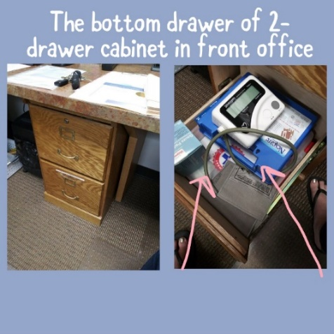
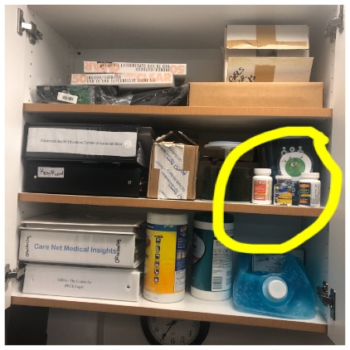
First aid kit
There are two first aid kits located in the bottom drawer of the 2-drawer cabinet in the front office. It also contains an antihistamine.
In the Ultrasound Room (top cabinet above the sink) there are OTC pain relievers and an antihistamine:
  Acetaminophen (same as Tylenol)
  Ibuprofen (same as Motrin)
  Aspirin
  Benadryl (or generic of)

Slide 26

ergonomics
Safe lifting: bend knees, hold item close to your body, and lift with legs.
Always reach safely to avoid falling
Use good body mechanics
Avoid repetitive motions and awkward positions

Slide 27
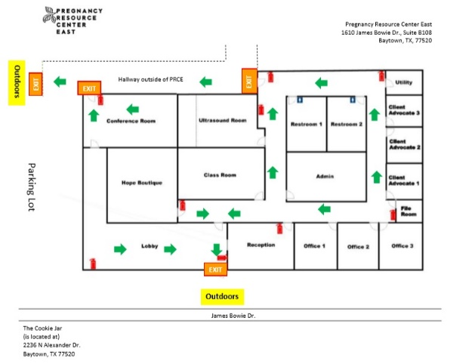
Emergencies
Fire or other emergency:
  Fire extinguishers are kept: conference room, 2 in lobby, entrance to Hope Store, near kitchenette, at exit near ultrasound room, near utility room, and file room.
  If with your client, assist her and those with her to leave with you through any of the exits from our map
  Meet in front of Bo Peep Shoppe 2338 N Alexander Dr. Baytown, TX 77520
  All staff and all volunteers report to Front Desk (Reception Area), Executive Director, and/or Center Director.
Tornado:
  Generally shelter in interior rooms on lowest floor without windows
  Hallways on the lowest floor away from doors and windows, and rooms constructed with reinforced concrete, brick, or block with no window
  All staff and all volunteers report to Executive Director , Front Desk (Receptionist Area), or Center Director
Panic button: installed April 2019 and again when we moved to James Bowie location
  Come to the reception area if you hear it activated. It sounds like a traditional door bell that can be heard from all rooms inside PRCE.

Slide 28
Workplace violence
Can occur at any time
Contributing factors:
  Long waiting periods
  Waiting and not knowing what’s going on
  Unwanted news
  Troubled home relationships of staff/volunteers
What to do:
  Stay calm
  Let the person leave if they’d like
  Allow them to reschedule
  Get staff into the room, get help
  Call 911 if necessary
  Run, Hide, Fight mentality
  Press panic button located at the right side under front desk computer on counter if you are in that area

Slide 29
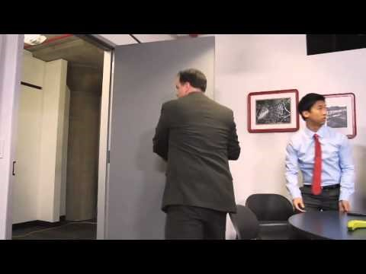
Run Hide fight
Video running time is 5 minutes. If it will not play for you, please pause here and do an internet search for, “run hide fight Ready Houston”.

Slide 30

Boundaries with clients
Once the professional relationship with your client becomes more personal, it puts you and PRCE at risk.
Contributing factors of risks:
  Unknown background of client
  Partner of client may become angry towards you or PRCE for getting involved
  You may not be able to provide the help the client is seeking
  Anyone in that client’s life may want to take revenge on you or the Center
What NOT to do:
  Give your personal phone number away
  Give a ride to a client for any reason
  Reveal your address nor your personal email address
  Give any kind of help outside of the resources at PRCE
  Accept invitations to the client’s personal functions or business opportunities
DO: Remain professional. This offers empowerment and confidentiality to your client.

Slide 31
Group post-test

Slide 32
1. Osha is the occupational safety and act/administration.

Slide 33
HEALTH

Slide 34
2. The purpose of the OSHA regulations is to ensure health and safety for whom?

Slide 35
EMPLOYEES

Slide 36
3. Osha always holds accountable for hazards.

Slide 37
THE EMPLOYER

Slide 38
4. PRCE’s Safety Coordinator is
.

Slide 39
Annis Felicien, MSN, RN

Slide 40
5. Our osha manual is kept where?

Slide 41

In the white cabinet next to the ultrasound room desk

Slide 42
6. I always have access to the osha manual and may receive a copy of the standards or policies upon request.
TRUE or FALSE

Slide 43
TRUE

Slide 44
7. List (any) four hazards that you may encounter at PRCE.

Slide 45
All of these are potential hazards to an employee of Prce:
Bloodborne Pathogens
Hazardous Chemicals
Fire
Electrical Hazards
Ergonomics
Walking & Working Surface Hazards
Workplace Violence/ Potential Terrorism
Tuberculosis
Covid-19 or other virulent diseases

Slide 46
8. Are you at risk for exposure to bloodborne pathogens?
YES or NO

Slide 47
Yes, if you do any of these:
Performing ultrasound exams
Cleaning exam tables
Cleaning ultrasound probes
Attending any vaginal ultrasound exams
Handling hazardous medical wastes (changing out any red trash bags labeled with Biohazard logo)
Monitoring self-administered pregnancy tests
Cleaning up after vomit or dirty diapers
Tending to children who may have sinus drainage
Cleaning children's toys
Sorting through clothing donations
* (During Covid 19) Speak to any client when you are less than 6 feet from them. The following is from OSHA during the pandemic:
  Blood-borne Pathogen Standard: Applies to occupational exposure to human blood and other potentially infectious materials. This standard does not typically include the respiratory secretions that may transmit COVID-19; however, OSHA believes it may provide guidance on controlling some sources of the virus, such as bodily fluids.

Slide 48
9. Define or describe “universal Precautions.”

Slide 49
Universal Precautions is treating blood and other potentially infectious materials (OPIM) as if known to be infectious.
Using Universal Precautions exercises the following:
  Proper personal protection equipment (PPE)
  Proper disposal of OPIM
  Proper treatment of any exposures

Slide 50
10. Match the symptom with the infection:
A. HIV 1. Jaundice
B. Hep B 2. Severe fatigue
C. Hep C 3. Swollen lymph glands

Slide 51
HIV – (3) Swollen lymph glands A3
Hep B – (1) Jaundice B1
Hep C – (2) Severe fatigue C2

Slide 52
11. Name one activity that may result in transmitting hepatitis or HIV.

Slide 53
Any activity involving potential contact with blood or other potentially infectious material, including:
  Cleaning contaminated surfaces and laundry
  Handling biohazardous waste
  Surgical procedures
  Hygiene procedures
  Chemical procedures
  Wound care
  Vaginal exam or vaginal sonogram

Slide 54
12. The minimum personal protective equipment that must be worn when performing a task that puts you at risk for exposure to an infectious agent is .

Slide 55
GLOVES

Slide 56
13. Name a symptom of latex allergy.

Slide 57
Symptoms of latex allergy can include any of the following:
  Dermatitis
  Irritation
  Asthma
  Anaphylaxis

Slide 58

14. Name one item other than gloves that contain latex.

Slide 59
There are numerous items including, but not limited to:
  Band-Aids
  Rubber stoppers
  Syringes
  Diaphragms
  Condoms
  Balloons
  Elastic
  Vaginal prove covers

Slide 60
15. Name the disinfectant you use and its “kill” time.

Slide 61
Lysol Disinfecting Wipes:
the “kill” time is 4 minutes!

Slide 62
16. Have you been given the opportunity to obtain the hepatitis b vaccination?

Slide 63
All staff and volunteers are given the opportunity to be vaccinated for Hepatitis B but it is not required.
Healthcare workers/volunteers are given the opportunity to be vaccinated but it is not required.
**All others need to sign a “Hepatitis B Declination Form” yearly.

Slide 64
17. What should you do if you have a bloodborne pathogen exposure?

Slide 65
Clean the area, then report it to the Safety Coordinator or Safety Directors

Slide 66
18. Where is our first aid kit stored?

Slide 67

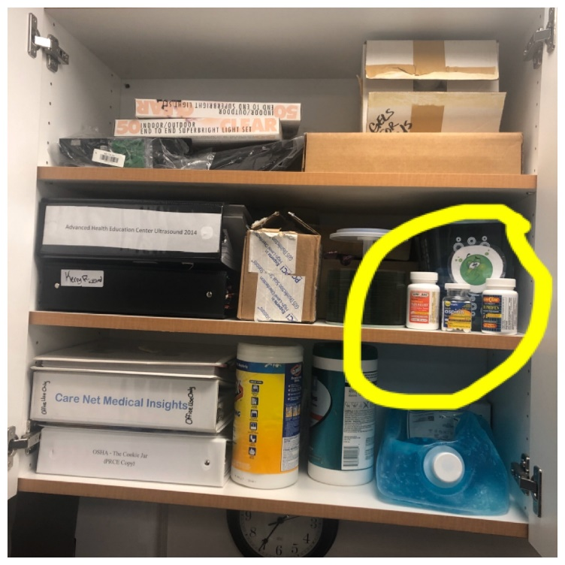
In the bottom drawer of the 2-drawer cabinet in the front office.
Also, there are three NSAIDS (over the counter pain relievers): In the Ultrasound Room, in top cabinet above the sink.

Slide 68
19. What is your responsibility in an emergency evacuation?

Slide 69
Help clients you are working with (and their guests) to evacuate
Report to Front desk (Reception Area), Executive Director and/or Center Director
Evacuate through the nearest exit and meet in front of Bo Peep Shoppe at:
  2338 N Alexander Dr., Baytown, TX 77520

Slide 70

20. Our designated meeting place is where?
2338 N Alexander Dr. Baytown, TX 77520

Slide 71
Bo Peep Shoppe!
2338 N Alexander Dr., Baytown, TX 77520

Slide 72
21. What is the emergency phone number anyone can use to get help?

Slide 73
911

Slide 74
22. Must every container be labeled?

Slide 75
YES

Slide 76
23. Describe the MSDS.

Slide 77
The Material Safety Data Sheet (MSDS) is a document prepared by the manufacturer to provide comprehensive information about the chemical, especially first aid and protection.

Slide 78
24. prce’s MSDS sheets are stored where?

Slide 79
Front office reception space hanging on the wall next to the window.
A duplicate can be found next to the sink on the wall in the ultrasound room.

Slide 80
25. Name a hazardous chemical you use and a hazard associated with it.

Slide 81
Lysol Disinfecting Wipes – May cause eye irritation - Avoid contact with eyes and wash hands after use

Slide 82
26. Give an example of an ergonomics hazard.

Slide 83
Lifting
Repetitive motions such as keyboarding
Strained positions such as wedging a phone between the ear and shoulder

Slide 84
27. A potential trigger for Workplace Violence in our office is , and we should respond by what?

Slide 85
Not keeping professional boundaries with clients
It could be a client upset by our waiting times, confidentiality issues, or questions.
It could be a boyfriend or husband upset by a client’s answers to her intake form or sonogram dates, etc.
It could be a troubled personal home relationship of one of your coworkers
We can respond by:
  Never giving out personal information or contacting client outside of PRCE
  Educate clients of wait times and any delays
  Allow clients the opportunity to reschedule
  Take a time-out if needed
  Try to appear calm outwardly, stay neutral
  Call 911 if necessary
  Run, Hide, Fight mentality

Slide 86

28. How is tuberculosis spread?
A. Bloodborne
B. Water/food borne
C. Airborne

Slide 87
C. AIRBORNE

Slide 88
29. Name one symptom of tuberculosis.

Slide 89
Symptoms of tuberculosis include, but are not limited to the following:
  Productive cough
  Coughing up blood
  Fever
  Weight loss

Slide 90
Congratulations!
You have successfully completed your OSHA Training!
Please complete and return:
PRCE OSHA HIPAA 2024 test
OSHA Contract signed
Signed Hepatitis B Declination (if you are NOT getting the vaccine). Email annisfprce@gmail.com for instructions if you want the Hep. B vaccine.
TB Prescreen Questionnaire
Continue on to the HIPAA Training!

Slide 91
HIPAA Training
Health Insurance Portability Accountability Act
Pregnancy Resource Center East 2024

Slide 92
Requirements
PRCE is not required to comply, but we choose to.

Slide 93

What’s the Purpose?
Protect privacy of health information
Protect patient rights

Slide 94
Privacy versus Security
PRIVACY refers to WHAT is protected
SECURITY refers to HOW private information is protected

Slide 95
Protected Health Information
PHI – patient health information relating to past, present, or future health of an individual
Formats considered protected:
  Electronic
  Paper
  Oral

Slide 96

Electronic Data Interchange Standards
Standards apply to:
  Electronic media (disk, CD, etc)
  Intranet, internet
  All phone lines
  Private networks
Standards don’t apply to:
  Phone conversations (being overheard)
  Faxes (ex: faxing to doctor’s office)
  Internal transmissions on a secured platform

Slide 97
Notice, Consent, and Authorization:
Authorizations must be signed by clients in order to release PHI for non-healthcare related uses (such as banquet testimony)

Slide 98

Disclosure of PHI
DHHS (U.S. Department of Health and Human Services) prohibits covered entities from using or disclosing PHI unless it is permitted or required in the rule.
If its not authorized by the client or required by law-it is private!

Slide 99
PHI Disclosure Exceptions:
Emergencies involving an imminent threat to health (earthquake, etc)
Where required by law (police officer looking for individual)
Law enforcement (court order)
Judicial proceedings (subpoena)
Incidental disclosures
Healthcare oversight activities
Public health activities
Research purposes (specific circumstances)
Specialized government functions
Organ transplants/procurement
Workers’ compensation
Coroners, medical examiners, funeral directors

Slide 100
Privacy: Minimum Necessary Disclosure
An effort must be made to only disclose the minimum amount of PHI necessary to accomplish the intended purpose of the disclosure (unless other authorization has been given).

Slide 101

Case Study:
A local OB/GYN requests the medical records from a patient’s recent visit. The RN makes a copy of the entire patient chart/file.
Was the RN correct in copying the entirety?
No, she should have only copied
what was necessary.

Slide 102

Case Study:
Alma, a volunteer at PRCE, learns that the daughter of her friend, Jill, from church is pregnant. She runs into Jill at church and congratulates her on her daughter’s pregnancy.
Is this a breach of HIPAA?
Absolutely!

Slide 103
Case Study:
A nurse working at Legacy also volunteers at PRCE. She sees that a PRCE client has come to the emergency room. She pulls the client information up at Legacy, and reports back to PRCE to make a follow up call to the client.
Is this a breach of HIPAA?
Absolutely! Unless the client
tells her to tell PRCE. Her PRCE
PHI is separate from her Legacy PHI, and
vice versa.

Slide 104
Case Study:
A volunteer at PRCE texts and emails a staff member the first name only of her client, communicating details about the pregnancy test for data entry.
Is this a breach of HIPAA?
Yes! No names or initials should be used at all when referring to our clients to each other electronically unless we have encrypted email service and currently we do not. Emails and texts are not secured, so only use client (file) numbers when communicating about them to each other. If said client does not have a number yet, name her something anonymous such as “New Client”, “Pre Client”, or “No Number”.

Slide 105
Incidental Disclosures:
Waiting room sign-in sheets (try to black out names if it’s for pregnancy testing, sonogram, or other medical services or use a HIPPA approved sign-in sheet)
Client files at front desk or any counter at PRCE (try to face away from traffic)
Staff/volunteers talking with clients and being overheard
Staff/volunteers talking with each other and being overheard
Not a breach provided safeguards were in place to minimize them.

Slide 106
Case Study:
Julie, a PRCE client, signs in for her sonogram appointment and happens to notice that her estranged sister was here for a pregnancy test this morning.
Was this a breach of HIPAA?
No, but we should make every attempt to conceal identity; such as crossing out the client names or peeling off the sign-in sticker asap.
(This is if we had a sign in sheet for sonograms or other medical services)

Slide 107
Case Study:
A client gave a verbal okay for her “story” to be used at a banquet. The speaker gave her full name and medical history (including HIV status) in his speech.
How could this breach of HIPAA be avoided?
By obtaining a written release
of information, and sharing the
minimal amount for the purpose.

Slide 108
Security:
The HIPAA Security Rule’s objective is to protect the confidentiality, integrity, and availability of PHI in electronic form.
  Computer information and print outs

Slide 109
General Requirements (Security Rule):
Administrative safeguards – policies and procedures, training
Physical safeguards – door locks, locked cabinets, fireproof storage of records, workstation privacy, etc
Technical safeguards – passwords, automatic log off, user IDs , audits, security logs, encryption, etc

Slide 110
Administrative Safeguards:
Information Access:
  Restrict to minimum: the minimum people with the minimum access that each one needs
  Never allow access rights to be transferred
  Review policies and procedures annually

Slide 111

Physical Safeguards:
Workstation security standard:
  Position monitors to avoid passersby
  Have password-protected screensavers
  Limit access to workstations, file cabinets, etc.

Slide 112
Case Study:
A PRCE staff member is teaching a volunteer how to use our computer system. She provides the volunteer with her password for future use.
Is this an allowable practice under HIPAA?
No, each staff or volunteer
should have his or her own login
and be limited to ‘as needed’
access.

Slide 113

Case Study:
A staff member steps away from her desk and leaves her computer pulled up to a client she’d been working with. A client is left waiting in the hallway, and sees her friend’s name on the computer, and that her pregnancy test was positive.
What can be done to prevent this accidental /incidental disclosure?
Position the screen away from
view, minimize or close the screen.

Slide 114

Case Study:
A Hope Program client is left waiting in the waiting room prior to her class. She notices a file at the front desk, opens it, and peruses it.
How could this breach of HIPAA be prevented?
All client files should be
kept in a lockable cabinet,
or at least out of reach.

Slide 115
Start Practicing HIPAA!
If you have any questions about Hipaa, please get in touch with Maegan maeganmprce@gmail.com
Thanks! You’re done with the 2024 osha and hipaa yearly self-training!

